Slide 1
Market Segment Revision 2019
Proprietary & Confidential Updated: July 30 2019

Slide 2
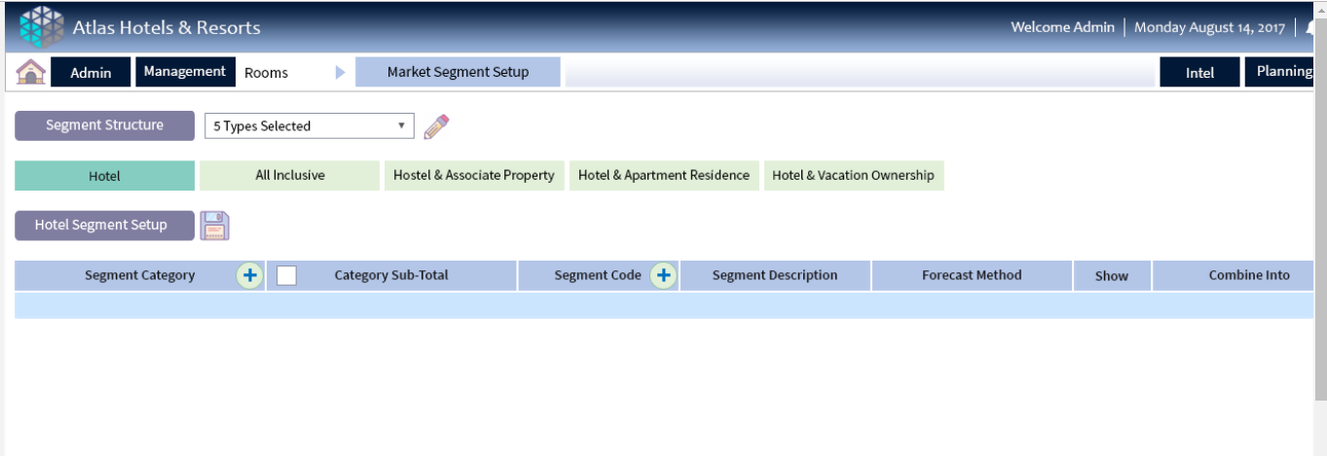
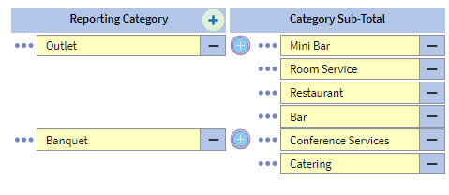
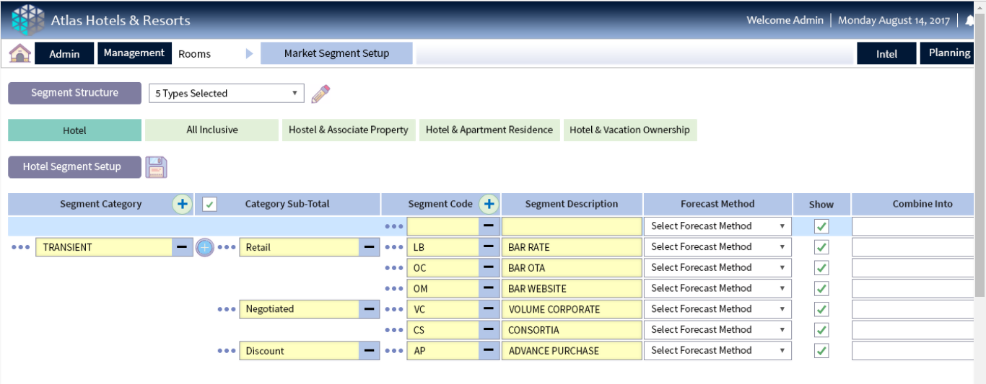
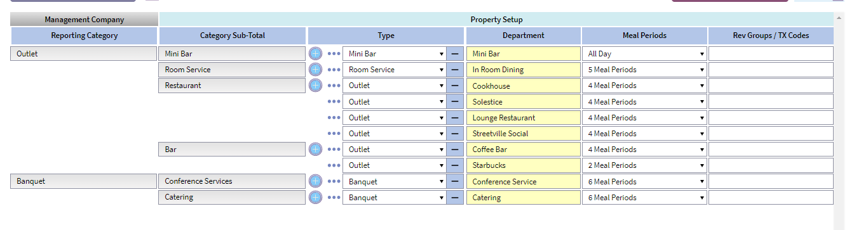
Market Segment Revision – UI Proposal
Management Co. Single Property Structure Editing
Step 2 – user sets up chart per type.. (same as now) all on one page
NO (CC) FINANCE CODES ON MGT CO SETUP MOVED TO FRS EXPORT

Slide 3
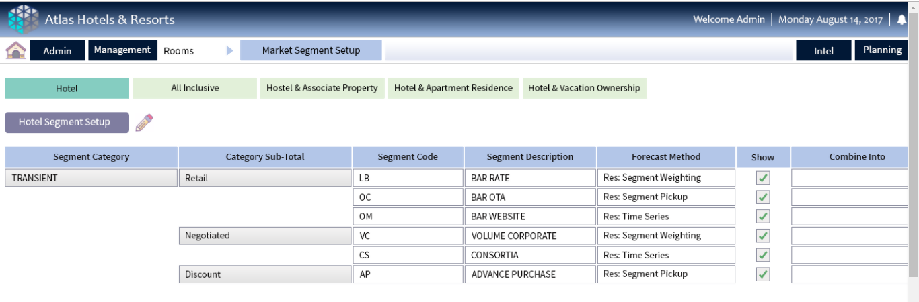
Market Segment Revision – UI Proposal
Management Co. Single Property Structure – Saved View

Slide 4
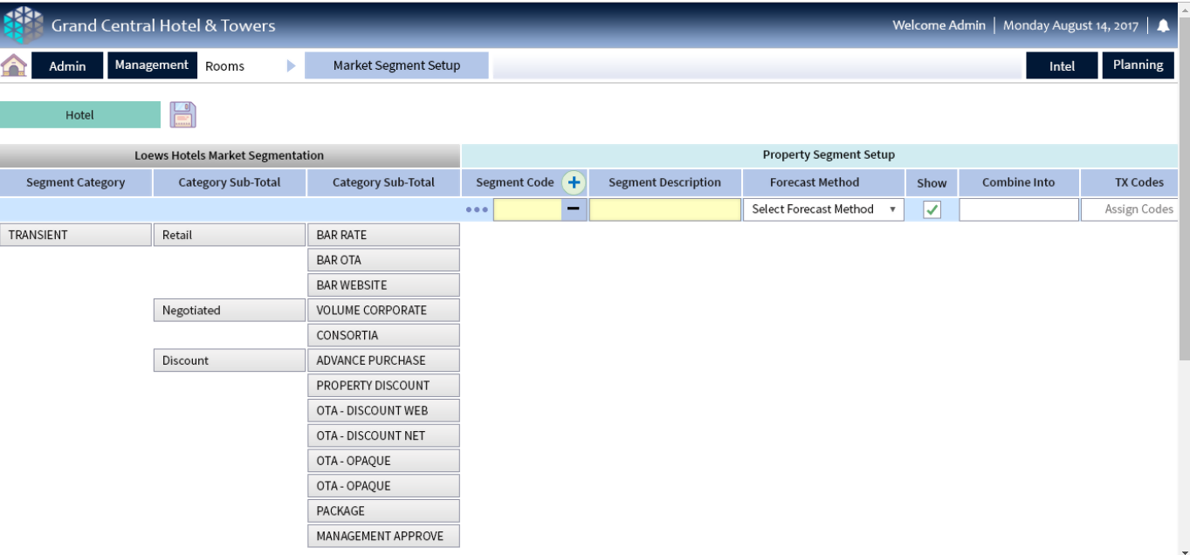
Market Segment Revision – UI Proposal
Property Single Property Structure Editing – Start View

Slide 5
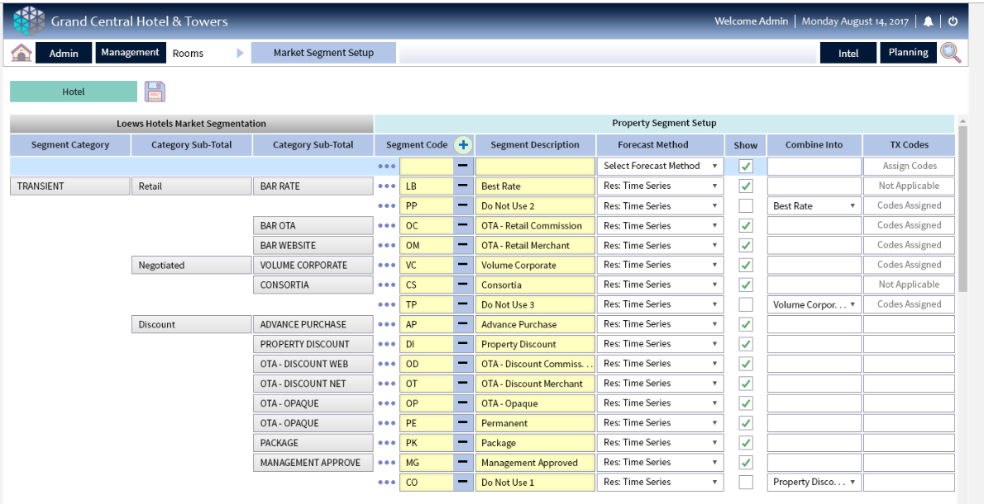
Market Segment Revision – UI Proposal
Property Single Property Structure Editing – Editing
Transaction code pop up not enabled in edit mode – but available in saved mode (same as F&B) message text indicates status
Assign Codes
Assign Codes
Assign Codes
Assign Codes

Slide 6
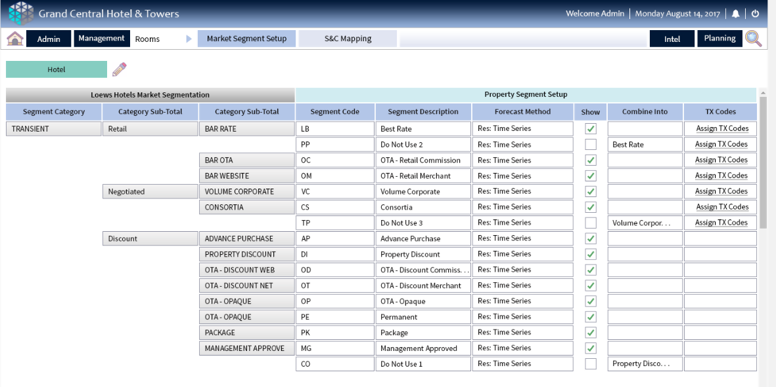
Market Segment Revision – UI Proposal
Property Single Property Structure Editing – Saved View

Slide 7
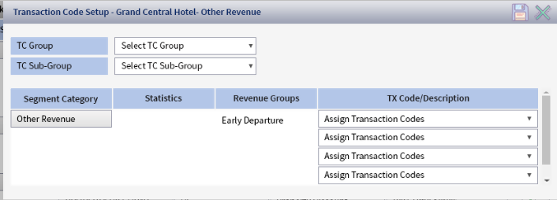
Market Segment Revision – UI Proposal TX Code Pop Up
Property Single Property Structure Editing – Edit View

Slide 8
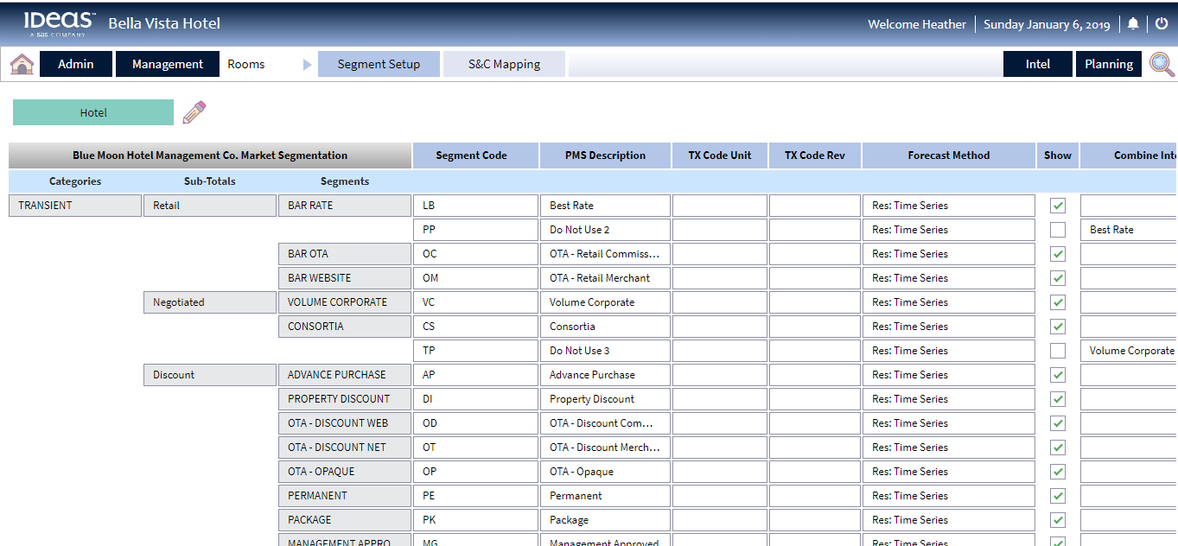
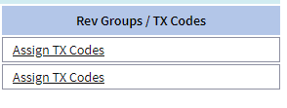
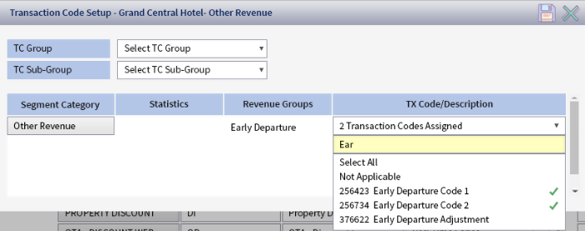
Market Segment Revision – UI Proposal – TX Code Pop Up Editing (label to confirm)
Other Revenue
Transaction Codes
Accommodation
Rooms

Slide 9
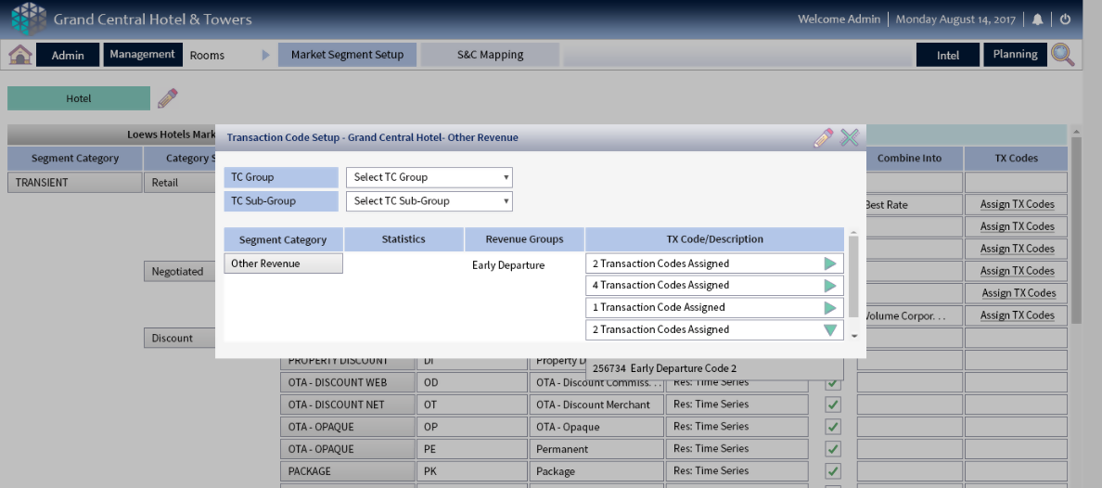
Market Segment Revision – UI Proposal – TX Code Pop Up Saved
Accommodation
Rooms

